Slide 1

SMART TRAFFIC SIGNAL TO OPTIMIZE WITH THE EMERGENCY VECHILE DETECTION
Presented by:
1.GOLLA.DEEPIKA(23491A0534)
2.GUDA.HEMA LATHA (23491A0536)
3.GUTHA.SRAVANTHI(23491A0540)
4.MEDAVARAPU.ANJANA CHARY (23491A0546)
5.NANDIKONDA.KIRAN KUMAR (23491A0549)
Assistant professor
BHASKAR SIR
Notes:
1

Slide 2
Outline
ABSTRACT
INTRODUCTION
LITERATURE REVIEW
MOTIVATION
OBJECTIVE
EXISTING METHOD
PROPOSED METHOD
HARDWARE & SOFTWARE INVOLVED
ADVANTAGES AND APPLICATION
SYSTEM ARCHITECTURE /PROPOSED WORK BLOCK DIAGRAM
UML DIAGRAMS
IMPLEMENTATION
RESULTS AND DISSCUSSIONS
CONCLUSION AND FUTURE SCOPE
REFERENCES
Notes:
2

Slide 3
ABSTRACT
Traffic congestion is a major issue in urban areas, causing delays and affecting emergency vehicle movement.
The proposed system — Smart Traffic Signal Control with Emergency Vehicle Detection — aims to improve traffic management and emergency response.
The system uses Infrared (IR) sensors in each lane to detect vehicle presence and traffic density.
Arduino Uno microcontroller processes sensor data and controls the traffic lights automatically.
When an emergency vehicle is detected, that lane gets an immediate green signal to clear the path.
In normal conditions, signals operate in a predefined cyclic manner based on vehicle presence.
The system provides a cost-effective and fully hardware-based solution without AI or image processing.
This approach ensures reduced waiting time, improved traffic flow, and priority passage for emergency vehicles.

Slide 4
INTRODUCTION
Rapid urbanization has led to a significant increase in the number of vehicles on roads, resulting in heavy traffic congestion.
Conventional traffic signal systems work on fixed time intervals, which often fail to handle dynamic traffic conditions effectively.
Emergency vehicles such as ambulances, fire trucks, and police cars often get delayed in traffic, leading to life-threatening situations.
To overcome these challenges, an intelligent traffic control system is needed that can adapt to real-time conditions.
The proposed system uses IR sensors to detect the presence of vehicles and Arduino Uno as the central controller to manage signal lights automatically.
When an emergency vehicle is detected, the system instantly gives a green signal to that lane to provide a clear route.
In normal situations, the system follows a cyclic signal pattern ensuring smooth flow for all directions.
This project aims to create a low-cost, hardware-based prototype that demonstrates the concept of smart traffic management without relying on complex AI systems.
Notes:
4

Slide 5
Literature Survey
Ref. No | Title & Author | Technique Used | Pros | Cons
1 | AI-Based Smart Traffic Signal Control System — Sasikala D., Sakthivel G., Sivachandiran R., Suriyabhuvanesh E. (2025) | CNN + Image Processing; Python | Achieved 1.3% MAPE; adaptive signals reduce congestion; scalable | Requires high-quality video input; computationally intensive
2 | AI-Based Traffic Management System — Reddy L. K., Shanthi Sree K. (2024) | Microcontroller for signal control | Detects multiple vehicle types; real-time dynamic signal changes | Limited by YOLOv3 accuracy in poor lighting/weather
3 | AI-Based Emergency Vehicles Detecting and Traffic Controlling System — Pawar A., Sutar Y. (2024) | CNN + IoT-enabled signals | Reduces emergency response time; adaptable to congestion levels | Needs reliable CCTV coverage; potential network latency
4 | AI-Driven Traffic Management System for Emergency Vehicle Prioritization Using YOLO — Pagare L., Pagrut K., Pahade L., Pahare S., Paigude P., Pakhare S. (2024) | YOLOv8 + CCTV + Push Bullet alerts | >95% ambulance detection accuracy; signal changes in ~2.5s | High training dataset requirement; may need strong GPU resources
5

Slide 6
MOTIVATION
Increasing traffic congestion in cities causes long waiting times and fuel wastage.
Emergency vehicles like ambulances and fire trucks often get stuck in traffic, risking human lives.
Conventional traffic lights work on fixed timers, ignoring actual traffic conditions.
There is a strong need for a smart and automatic system that can respond to real-time situations.
Developing a system that can detect emergency vehicles and give them priority will help save valuable time.
Using IR sensors and Arduino provides a simple, low-cost way to demonstrate intelligent traffic control.
The project encourages the use of automation and embedded systems to solve real-world problems effectively.

Slide 7
OBJECTIVE
To design and develop a smart traffic signal control system using hardware components.
To detect vehicles on each lane using IR sensors and control traffic signals automatically.
To identify emergency vehicles and give them priority clearance by turning the signal green in that lane.
To ensure smooth and efficient traffic flow by minimizing unnecessary waiting times.
To implement a low-cost prototype using Arduino Uno and basic electronic components.
To reduce response time for emergency vehicles, improving road safety.
To demonstrate how automation can enhance existing traffic control systems.
Notes:
7

Slide 8
EXISTING METHOD
Most cities use fixed-time traffic signal systems, where each signal changes after a preset duration.
These systems do not adapt to real-time traffic density or emergencies.
Traffic lights operate on a loop cycle, even if some lanes are empty.
Manual control by traffic police is sometimes used during heavy traffic, but it is not efficient or consistent.
Emergency vehicles like ambulances and fire trucks often get delayed because the system cannot detect or prioritize them.
Some advanced systems use cameras and AI-based monitoring, but they are expensive and complex to implement.
Existing methods therefore result in wasted time, fuel consumption, and delayed emergency responses.

Slide 9
PROPOSED METHOD
The proposed system aims to make the traffic control process automatic and intelligent using hardware components.
Infrared (IR) sensors are placed on each lane to detect the presence and density of vehicles.
An Arduino Uno microcontroller acts as the brain of the system, processing the signals received from the sensors.
When an emergency vehicle is detected through a dedicated IR sensor signal, the controller immediately turns the green light ON for that lane.
If no emergency vehicle is detected, the system operates in a normal cyclic pattern to manage regular traffic flow.
The signal time can be adjusted based on the number of vehicles detected in each lane.
The use of LED traffic lights and simple sensors makes the system cost-effective and easy to implement.
This method ensures faster clearance for emergency vehicles, less congestion, and improved traffic efficiency.
The prototype demonstrates a real-time, automated traffic signal control system without the need for complex AI or camera-based detection.

Slide 10

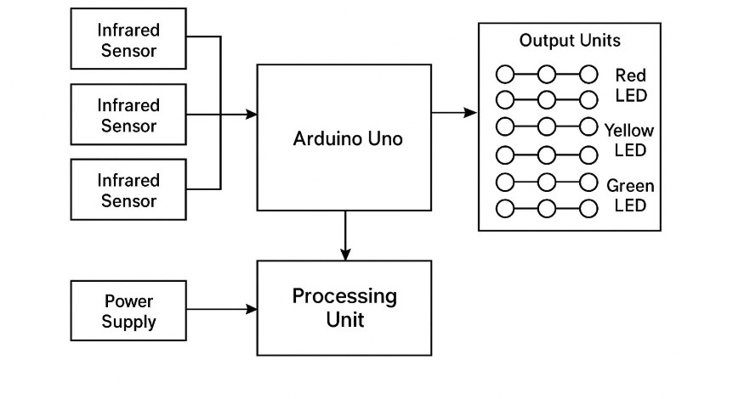
BLOCK DIAGRAM

Slide 11
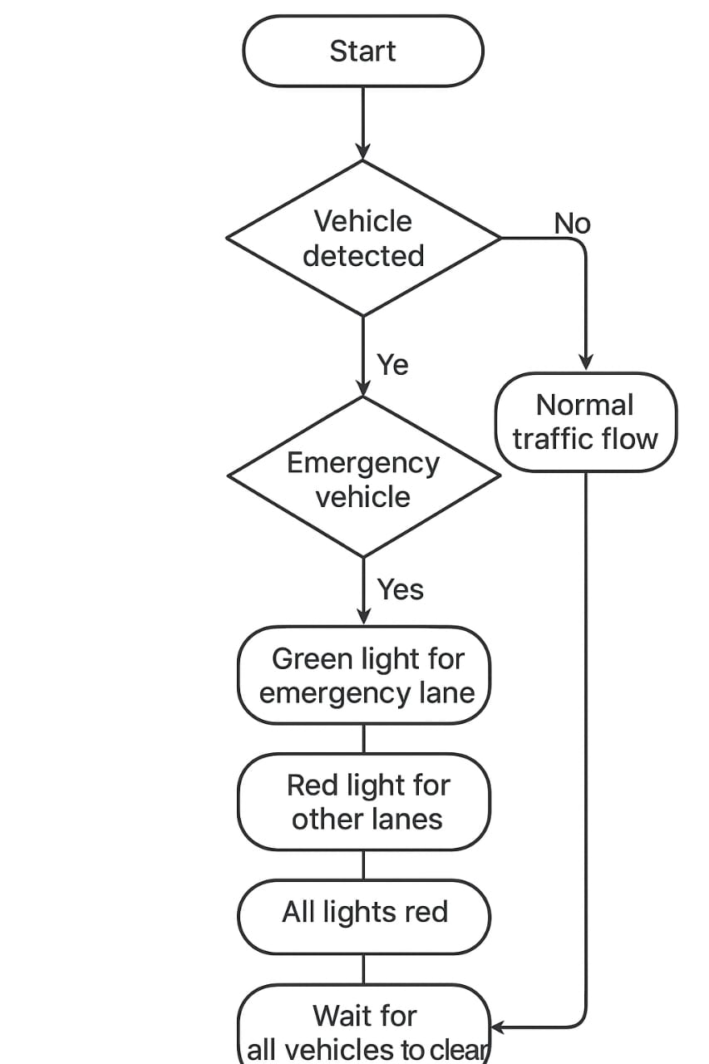
UML DIAGRAM
UML diagram:

Slide 12
IMPLEMENTATION
// Smart Traffic Signal Optimized with Emergency Vehicle Detection// Define LED pins for 4 directions (Red, Yellow, Green)int red1 = 2, yellow1 = 3, green1 = 4;int red2 = 5, yellow2 = 6, green2 = 7;int red3 = 8, yellow3 = 9, green3 = 10;int red4 = 11, yellow4 = 12, green4 = 13;// Emergency Vehicle Sensors (IR / RF)int emergencySensor1 = A0;int emergencySensor2 = A1;int emergencySensor3 = A2;int emergencySensor4 = A3;void setup() { // Set LEDs as outputs pinMode(red1, OUTPUT); pinMode(yellow1, OUTPUT); pinMode(green1, OUTPUT); pinMode(red2, OUTPUT); pinMode(yellow2, OUTPUT); pinMode(green2, OUTPUT); pinMode(red3, OUTPUT); pinMode(yellow3, OUTPUT); pinMode(green3, OUTPUT); pinMode(red4, OUTPUT); pinMode(yellow4, OUTPUT); pinMode(green4, OUTPUT); // Sensors as input pinMode(emergencySensor1, INPUT); pinMode(emergencySensor2, INPUT); pinMode(emergencySensor3, INPUT); pinMode(emergencySensor4, INPUT);
// Start with default state allRed();}void loop() { // Check for emergency vehicles if (digitalRead(emergencySensor1) == HIGH) { givePriority(1); } else if (digitalRead(emergencySensor2) == HIGH) { givePriority(2); } else if (digitalRead(emergencySensor3) == HIGH) { givePriority(3); }
else if (digitalRead(emergencySensor4) == HIGH) { givePriority(4); } else { // Normal Traffic Cycle normalTrafficCycle(); }}// Function: Turn all signals REDvoid allRed() { digitalWrite(red1, HIGH); digitalWrite(yellow1, LOW); digitalWrite(green1, LOW);
digitalWrite(red2, HIGH); digitalWrite(yellow2, LOW); digitalWrite(green2, LOW); digitalWrite(red3, HIGH); digitalWrite(yellow3, LOW); digitalWrite(green3, LOW); digitalWrite(red4, HIGH); digitalWrite(yellow4, LOW); digitalWrite(green4, LOW);}// Function: Give Emergency Vehicle Priorityvoid givePriority(int road) { allRed(); // stop all others if (road == 1) { digitalWrite(red1, LOW); digitalWrite(green1, HIGH); } else if (road == 2) { digitalWrite(red2, LOW); digitalWrite(green2, HIGH); } else if (road == 3) { digitalWrite(red3, LOW); digitalWrite(green3, HIGH); } else if (road == 4) { digitalWrite(red4, LOW); digitalWrite(green4, HIGH); } delay(7000); // Keep green for emergency vehicle allRed();}// Function: Normal Traffic Cyclevoid normalTrafficCycle() { // Road 1 Green digitalWrite(red1, LOW); digitalWrite(green1, HIGH); delay(4000); digitalWrite(green1, LOW); digitalWrite(yellow1, HIGH); delay(2000); digitalWrite(yellow1, LOW); digitalWrite(red1, HIGH); // Road 2 Green digitalWrite(red2, LOW); digitalWrite(green2, HIGH); delay(4000); digitalWrite(green2, LOW); digitalWrite(yellow2, HIGH); delay(2000); digitalWrite(yellow2, LOW); digitalWrite(red2, HIGH); // Road 3 Green digitalWrite(red3, LOW); digitalWrite(green3, HIGH); delay(4000); digitalWrite(green3, LOW); digitalWrite(yellow3, HIGH); delay(2000); digitalWrite(yellow3, LOW); digitalWrite(red3, HIGH); // Road 4 Green digitalWrite(red4, LOW); digitalWrite(green4, HIGH); delay(4000); digitalWrite(green4, LOW); digitalWrite(yellow4, HIGH); delay(2000); digitalWrite(yellow4, LOW); digitalWrite(red4, HIGH);}

Slide 13
HARDWARE AND SOFTWARE COMPONENTS
Hardware Components:
Arduino UNO – acts as the main controller that processes input from sensors and controls traffic lights.
IR Sensors (4 units) – placed on each lane to detect the presence of vehicles and identify emergency vehicle approach.
LEDs (Red, Yellow, Green) – represent traffic lights for each lane.
Resistors – used to limit current and protect the LEDs and sensors.
Jumper Wires – for interconnections between sensors, LEDs, and the Arduino board.
Breadboard / PCB – used for circuit assembly and testing.
Power Supply (5 V / USB) – provides operating voltage to the Arduino and other components.
Software Components:
Arduino IDE – used to write, compile, and upload code to the Arduino board.
Embedded C / C++ Language – programming language used for controlling the hardware components.
Proteus / Tinkercad (optional) – for circuit simulation and testing before hardware implementation.
Serial Monitor (Arduino IDE) – to observe sensor data and debug the system.

Slide 14
i
ADVANTAGES AND APPLICATIONS
ADVANTAGES:
Automatic Control: The system automatically detects emergency vehicles and adjusts traffic lights accordingly.
Faster Emergency Response: Provides immediate green light for ambulances, fire trucks, etc., reducing travel time.
Efficient Traffic Flow: Minimizes congestion and waiting time for other vehicles.
Low Cost & Easy Implementation: Uses affordable sensors and microcontroller-based design
Energy Efficient: LEDs and smart control logic reduce unnecessary power consumption.
Scalable & Upgradable: Can be integrated with IoT or wireless modules in future enhancements.
APPLICATIONS:
Urban Traffic Management Systems: For real-time smart traffic control at major intersections.
Hospitals & Emergency Routes: Ensures quick passage of ambulances and other emergency services.
Police and Fire Department Vehicles: Helps priority vehicles reach destinations faster.
Educational Demonstrations: Useful for learning automation, sensors, and IoT integration concepts.
Smart City Projects: Forms a building block for intelligent transport infrastructure.

Slide 15
Application & Advantages
Applications:
Emergency Vehicle Priority Provides a clear path for ambulances, fire trucks, and police vehicles at intersections.
Smart City Traffic Management Can be integrated into intelligent traffic systems for modern smart cities.
Hospitals and Emergency Zones Ensures quick clearance of traffic near hospitals and emergency care units.
High-Density Urban Areas Reduces delays for emergency vehicles in crowded city traffic .
Integration with IoT Can be extended to create green corridors by linking multiple junctions.
Advantages:
Emergency Vehicle Priority.
Provides a clear path for ambulances, fire trucks, and police vehicles at intersections.
Smart City Traffic Management Can be integrated into intelligent traffic systems for modern smart cities.
Hospitals and Emergency Zones Ensures quick clearance of traffic near hospitals and emergency care units.
High-Density Urban Areas Reduces delays for emergency vehicles in crowded city traffic.
Integration with IoT Can be extended to create green corridors by linking multiple junctions.

Slide 16
RESULTS AND DISCUSSIONS
Results:
The system successfully controlled four traffic lanes using Arduino-based signal control
When an IR sensor detected an emergency vehicle, the corresponding lane’s green light was immediately activated, while all other directions turned red.
The system returned to normal traffic cycle automatically after the emergency vehicle passed.
The response time for switching lights was found to be very quick (less than one second after detection).
Manual testing with a remote-controlled emergency signal confirmed reliable detection in all four directions.
The circuit consumed very low power, proving suitable for continuous operation.
Discussion:
The results validate that the system can effectively prioritize emergency vehicles without human intervention.
The design shows how multiple IR sensors can be used to monitor each road and synchronize with traffic lights.
The setup demonstrates high reliability for prototype-level deployment and can be scaled up for real intersections using wireless or camera-based detection.
By eliminating manual operation, the project enhances both traffic management efficiency and public safety.
This approach proves that low-cost microcontroller systems (like Arduino) can perform real-time intelligent control with minimal hardwar
Future improvements may include integrating IoT modules, GPS data, or sound sensors for advanced detection and cloud monitoring.

Slide 17
CONCLUSION AND FUTURE SCOPE
Conclusion:
The project successfully demonstrates an Arduino-based intelligent traffic control system capable of prioritizing emergency vehicles in real time.
The integration of four IR sensors effectively monitored all lanes, allowing the system to instantly switch signals for emergency vehicles while maintaining normal traffic flow once the emergency passed.
The quick response time (less than one second) and low power consumption confirm that the system is efficient, reliable, and suitable for continuous operation.
This prototype validates that low-cost microcontroller-based solutions can significantly enhance traffic management, reduce human dependency, and improve public safety in urban environments.
Future scope:
IoT Integration: Connecting the system to the cloud can allow remote monitoring and centralized traffic management.
Advanced Detection Methods: Incorporating GPS-based vehicle tracking, sound sensors, or camera-based image recognition can enhance emergency vehicle detection.
Scalability: The system can be expanded to handle multiple intersections and synchronized traffic corridors.
Adaptive Traffic Control: Algorithms can be implemented to optimize signal timing dynamically based on real-time traffic density.
Energy Efficiency: Integration with solar-powered traffic lights can make the system more sustainable.
Public Safety Enhancements: Alerts can be sent to nearby vehicles or traffic apps when an emergency vehicle is approaching.

Slide 18
THANK YOU

